Slide 1
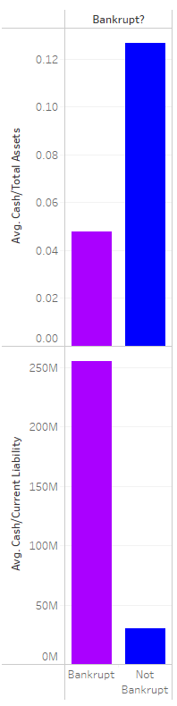
Bankrupt vs Non Bankrupt Indicator comparison
We were able to use Tableau for a basic visual.
This graph shows what you would expect when you compare the average ratio for cash/assets and cash/ liabilities for bankrupt and non bankrupt companies.
Assets are anything of value that can be converted to cash, in the data the non bankrupt companies have an average ratio of .12664 and bankrupt companies .04774.
Liabilities is something a company owes, the non bankrupt companies have an average liability of $30M and bankrupt companies is $256M.

Slide 2
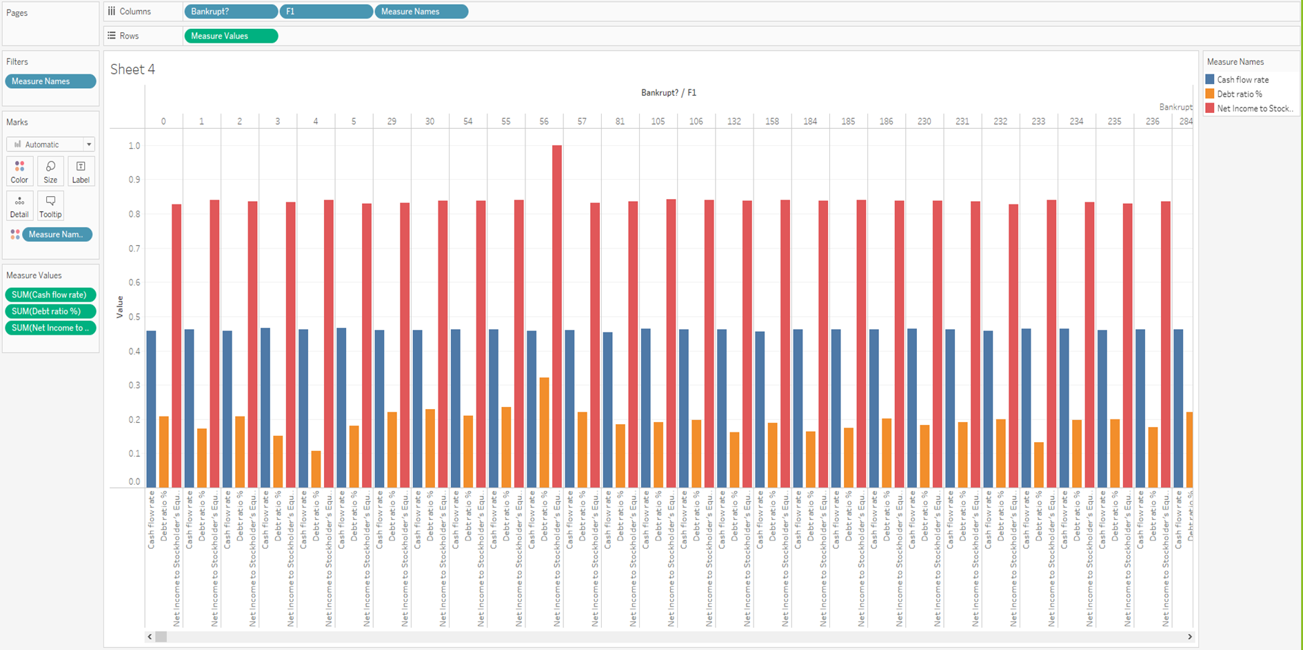
Bankrupt vs Non Bankrupt Indicator comparison
In Tableau, it was a challenge to put together visuals to analyze individual factors by each company as we had too many companies and we wanted to show more than one ratio. This is a visual of what the data looked like when we attempted to this.

Slide 3
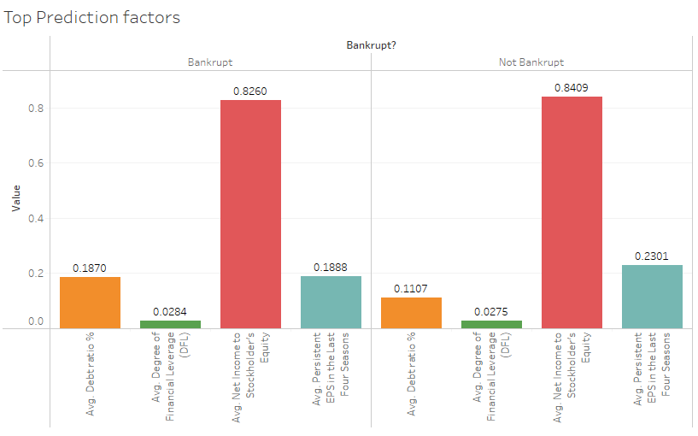
Bankrupt vs Non Bankrupt Indicator comparison
This is a graph based on the previous slide which was modified to make it more understandable. We removed the individual company from the columns and looked at 4 of the top prediction factors identified through machine learning. There was a total of 41 factors which could not all be included in one graph. Issues we ran into with this was that some indicators were ratios while others were dollars so the ratios did not appear since they were decimals. The four factors we used did not have a drastic variances like we saw with the liability and asset when we compared them for the bankrupt and non bankrupt companies.

